Slide 1

Author Profiling
Mircea Popescu Adrian Ispas

Slide 2
Who host the competition?
PAN is a series of scientific events and shared tasks on digital text forensics and stylometry.
PAN fosters digital text forensics research by organizing shared task evaluations. Shared tasks are computer science events that invite researchers and practitioners to work on a specific problem of interest, the task.

Slide 3
Shared Tasks @ PAN - Authorship
Author Identification
Authorship Attribution: Given a document and a set of candidate authors, determine which of them wrote the document.
Style Change Detection: Given a document, determine whether it was written by a single or multiple authors.

Slide 4
Shared Tasks @ PAN - Authorship
Author Profiling
Gender Prediction: Given a document, determine its author's gender.
Celebrity Profiling: Given a Social Media feed, determine the owners traits.

Slide 5
Shared Tasks @ PAN - Trust
Credibility Analysis
Hyperpartisan News Detection: Given a news article, predict whether it is hyperpartisan or not.
Wikipedia Vandalism Detection: Given an edit on a Wikipedia article, determine whether it is vandalism.

Slide 6
Shared Tasks @ PAN - Originality
Text Reuse Detection (aka Plagiarism Detection)
Intrinsic Plagiarism Detection: Given a document, determine if parts of it have been written by different authors.
External Plagiarism Detection Given a document and a set of documents, determine whether parts of the former have been reused from the latter.

Slide 7
PAN @ CLEF 2019
More info about PAN active tasks at
https://pan.webis.de/clef19/pan19-web/

Slide 8
Bots and Gender Profiling
Given a Twitter feed, determine whether its author is a bot or a human. In case of human, identify her/his gender.

Slide 9
Bots and Gender Profiling - General info
Social media bots pose as humans to influence users with commercial, political or ideological purposes. For example, bots could artificially inflate the popularity of a product by promoting it and/or writing positive ratings, as well as undermine the reputation of competitive products through negative valuations.

Slide 10
Bots and Gender Profiling - General info
The threat is even greater when the purpose is political or ideological (see Brexit referendum or US Presidential elections). Fearing the effect of this influence, the German political parties have rejected the use of bots in their electoral campaign for the general elections.

Slide 11
Bots and Gender Profiling - General info
Furthermore, bots are commonly related to fake news spreading. Therefore, to approach the identification of bots from an author profiling perspective is of high importance from the point of view of marketing, forensics and security.

Slide 12
Bots and Gender Profiling - Dataset
4120 english Twitter users with a feed of 100 tweets per user
2060 bots - 50%
1030 female - 25%
1030 male - 25%
Train - 80%
1648 bots - 50%
824 female - 25%
824 male - 25%
Test - 20%
412 bots - 50%
206 female - 25%
206 male - 25%

Slide 13
Bots and Gender Profiling - Dataset
3000 spanish Twitter users with a feed of 100 tweets per user
1500 bots - 50%
750 female - 25%
750 male - 25%
Train - 80%
1200 bots - 50%
600 female - 25%
600 male - 25%
Test - 20%
300 bots - 50%
150 female - 25%
150 male - 25%

Slide 14
Bots and Gender Profiling - Dataset
Can you guess?
Imagine if Giroud went back to Arsenal. That would be fantastique. Will be talking about some new Irish tunes at 7:30pm on @theirishjam this evening! https://t.co/oqFnoApCV9 *Incredibly..... I can't see properly through my glassy eyeballs. So happy for Giroud. Incredible sad for Modric. Hate Griezmann even more. France could end their twenty year wait to reclaim the title Les Pimps, but Croatia could get their first World Cup honour. So conflicted about who I want to win today. I love Giroud but now I also love Modrić. I have Croatia in a sweepstakes and could win big coin, however Giroud could win a World Cup medal...

Slide 15
Bots and Gender Profiling - Dataset
Can you guess?
Women's marches protest #DonaldTrump on anniversary of inauguration – live #WomansMarch Community campaign… RT @ruth_hunt: 40% of #trans people have experienced hate crime in the last 12 months. 40%. Trans people are facing unprecedented levels of… RT @jeremycorbyn: Very important report by @StonewallUK about the discrimination and harassment trans people face every day. We must all do… RT @FrancesOGrady: Shocked by today's @stonewalluk report, showing that trans workers still face bullying, harassment and even physical vio… @jeremycorbyn on #Carillion: we'll

Slide 16
Bots and Gender Profiling - Dataset
Can you guess?
@KidrauhlsFredoo just saying he always looks like that with fans, so it's not a new look, lol @KidrauhlsFredoo he is always like that with fans.. Would you #FitchTheHomeless? #JustinBieber is hiking #Belieber #Beliebers #jb #hiking #haveaniceday RT @OMGtrolls: O.O RT @AhoyBieber: Awwww but that is cute is sang for fans from the roof of his hotel. Justin's original idea to release music has gone out the window, That was Justin's was if releasing music differently, u srs scooter? No one love like we do @biebersvideo: i'm not hating on scooter. i'm just disappointed of him. She's been my idol since day 1. She's worked so hard! #votearianagrande http://t.co/EPyBDwm22L RT @marucosu1919: ♥ＲＥＴＷＥＥＴ ♥ ＩＦ ♥ ＹＯＵ ♥ ＦＯＬＬＯＷ ♥ ＢＡＣＫ♥ #TeamFollowBack #TFBJP #followme #ifollownGain #TeamFollowWack #autofollowback #foll… I was stupid and you're the best dad in the world RT @elaph1421: I feel very bored

Slide 17
Bots and Gender Profiling - Dataset
Can you guess? - Truths
female
male
bot

Slide 18
Bots and Gender Profiling - Dataset
Can you guess? - Bonus: It was a female, it looks like a bot, we predicted male
http://t.co/0ljEdXFHFd @CelebrateWoking any chance you could RT? Firewalk in #Woking + raise crucial funds for local @samaritans!
http://t.co/Xd8b3UmYNq @welovewoking1 can you spare a RT? Firewalk in #Woking + raise crucial funds for local Samaritans branch!
http://t.co/nFMqybjpWV @WokingFairtrade any chance you could RT? Firewalk in #Woking + raise crucial funds for local Samaritans!
http://t.co/TOoUPuqU8v @WokingWorks can you spare a RT? Firewalk in #Woking + raise crucial funds for local Samaritans branch.
http://t.co/No6znazkl3 @Wokingpeople any chance you could RT? Firewalk in #Woking + raise crucial funds for local Samaritans!
http://t.co/nn0fQ7V0wX @thebestofWoking any chance you could RT? Firewalk in #Woking + raise crucial funds for local Samaritans!
http://t.co/Bk9dSKlgFJ @WokingNews any chance you could RT? Firewalk in #Woking + raise crucial funds for local Samaritans!
http://t.co/HY1Hsei5tS @TheGuildfordMag any chance you could RT? Firewalk in #Woking + raise crucial funds for local @samaritans!
http://t.co/9qxtX6vnYu @Woking_NewsMail can you spare a RT? Firewalk in #Woking + raise crucial funds for local @samaritans!
http://t.co/oIhId46l2p @wokingcouncil any chance you could RT? Firewalk in #Woking + raise crucial funds for local @samaritans!

Slide 19
Our first aproach
Description
First of all we analyzed the tweets with a preselected list of features like
number of words
number of characters
average word len
number of tags
number of hashtags
readability

Slide 20
Our first aproach
Full list of preselected features
number of words
number of characters
average word len
number of stop words
number of tags
number of hash tags
readability
number of digits
number of secure links
number of unsecured links
number of percent
number of exclamation marks
number of ampersands
number of question marks
number of commas
number of points
number of emoji
number of tildes
number of dollars
number of circumflex accents
number of stars
number of parenthesis
number of minuses
number of underscores

Slide 21
Our first aproach
Full list of preselected features
number of equals
number of pluses
number of brackets
number of curly brackets
number of vertical bars
number of semicolons
number of colons
number of apostrophes
number of grave accents
number of quotation marks
number of slashes
number of less grater than signs
number of words in bot popular words
number of words in human popular words
number of words in male popular words
number of words in female popular words
number of words in bot human popular words
number of words in human bot popular words
number of words in male female popular words
number of words in female male popular words
number of different words

Slide 22
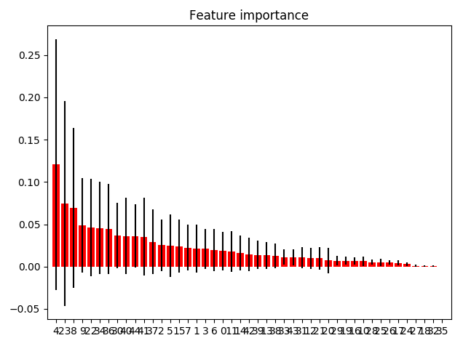
Our first aproach
Analyze the features importance - english tweets

Slide 23
Our first aproach
Analyze the features importance - english tweets
Feature ranking:
feature number_of_tags (0.120796)
feature number_of_underscores (0.074468)
feature number_of_secure_links (0.069672)
feature number_of_unsecured_links (0.048733)
feature number_of_minuses (0.046184)
feature number_of_slashes (0.045739)
feature number_of_words_in_bot_popular_words (0.044224)
feature number_of_colons (0.036617)
feature number_of_words_in_bot_human_popular_words (0.036190)
feature number_of_different_words (0.035950)

Slide 24
Our first aproach
Analyze the features importance - english tweets
Feature ranking:
feature number_of_words_in_human_bot_popular_words (0.035294)
feature number_of_words_in_human_popular_words (0.029117)
feature average_word_len (0.025417)
feature number_of_hash_tags (0.024680)
feature number_of_emoji (0.024076)
feature number_of_digits (0.022433)
feature number_of_characters (0.021563)
feature number_of_stop_words (0.021126)
feature readability (0.019482)
feature number_of_words (0.018321)

Slide 25
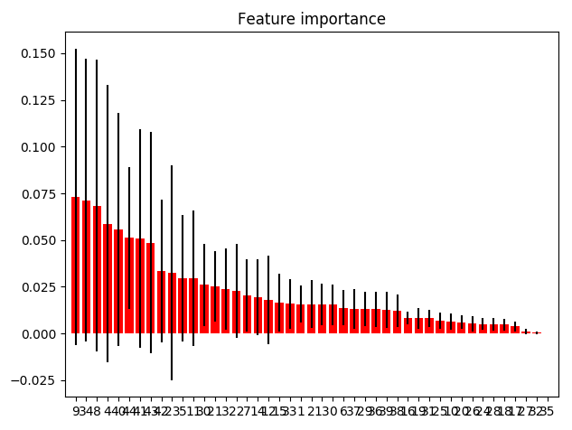
Our first aproach
Analyze the features importance - spanish tweets

Slide 26
Our first aproach
Analyze the features importance - spanish tweets
Feature ranking:
feature number_of_unsecured_links (0.073139)
feature number_of_slashes (0.071352)
feature number_of_secure_links (0.068457)
feature number_of_tags (0.058727)
feature number_of_words_in_bot_human_popular_words (0.055715)
feature number_of_different_words (0.051218)
feature number_of_words_in_human_bot_popular_words (0.050857)
feature number_of_words_in_female_male_popular_words (0.048649)
feature number_of_words_in_male_female_popular_words (0.033332)
feature number_of_underscores (0.032508)

Slide 27
Our first aproach
Analyze the features importance - spanish tweets
Feature ranking:
feature number_of_hash_tags (0.029529)
feature number_of_exclamation_marks (0.029466)
feature number_of_colons (0.025968)
feature number_of_parenthesis (0.025111)
feature number_of_stop_words (0.023783)
feature number_of_minuses (0.022810)
feature number_of_digits (0.020234)
feature number_of_points (0.019451)
feature number_of_question_marks (0.018032)
feature number_of_emoji (0.016574)

Slide 28
Our first aproach
Go closer to features - popular words for english bots - human
http, co, t, job, develop, engin, softwar, manag, hire, and, senior, locat, descript, career, system, is, tech, of, techjob, technolog, itjob, analyst, servic, ly, project, busi, applic, compani, posit, data, experi, java, design, lead, medic, solut, respons, full, support, histori, net, sr, provid, technic, bit, learn, team, network, tip, read, us, id, check, comput, health, picard, consult, product, client, seek, 0, requir, will, test, secur, date, introduct, scrum, with, web, architect, inform, inc, market, detail, 18, com, type, custom, gt, opportun, python, site, sql, contract, 2018, 1, program, work, our, california, oper, master, unit, specialist, avail, titl, administr, state, it

Slide 29
Our first aproach
Go closer to features - popular words for english male - female
the, a, that, is, it, he, but, game, be, they, not, for, play, it\', good, fuck, as, out, man, _tessathoma, or, no, new, if, team, him, vancouv, he\', in, fan, what, of, gt, mate, that\', will, win, wa, great, don\'t, at, season, fundris, well, trump, get, think, some, look, leagu, ha, 2, got, goal, point, boardoftrad, babyboom, big, one, up, from, see, ani, go, than, there, stanleycup, would, nice, come, also, beer, now, time, footbal, 1, johnbdeleo, 0, cup, onli, though, guy, celtic, should, citi, club, off, score, then, lad, eritrea, first, sure, car, paint, might, two, sign, again, 3

Slide 30
Our first aproach
Go closer to features - popular words for english female - male
rt, t, http, you, co, to, i, your, amp, and, video, so, mailonlin, love, our, can, my, me, thank, social, her, women, pleas, u, s, she, with, thejournal_i, comment, girl, youtub, peopl, how, find, x, via, immersivemind, day, vichislop, happi, life, facebook, m, app, screen, mvsgrperli, term, today, dm, about, girlstream, innov, xx, media, oyvj3tkix8, grab, feel, footag, account, fulli, law, here, credit, fcm_onlin, eurotoquesirl, mariankey, homebusi, woman, busi, food, we\'ll, newsflar, market, morn, vickinotaro, school, send, instagram, de, networkmarket, hootsuit, don, work, shaunamp, help, twitchshar, holiday, are, beauti, snapchat, film, omg, fab, mamaofabean, men, learn, join, 2018, stori, contact

Slide 31
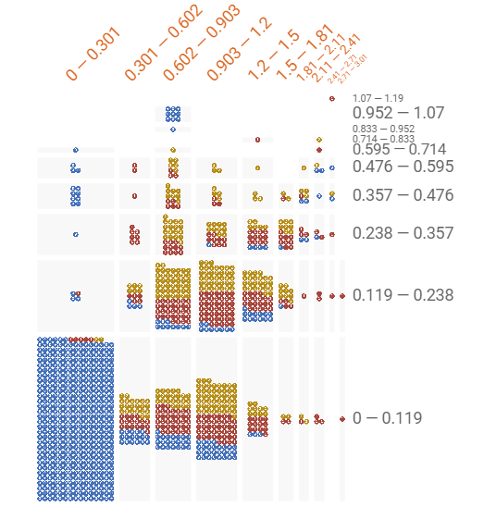
Our first aproach
Go closer to features - number of tags and number of underscores
X axis - number of tags
Y axis - number of underscores

Slide 32
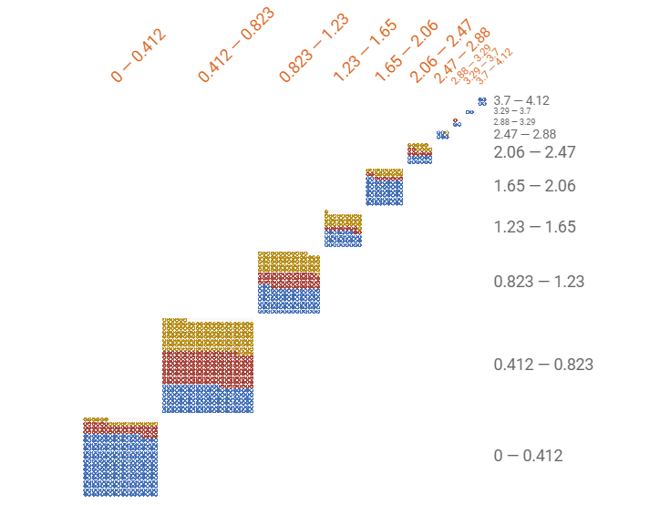
Our first aproach
Go closer to features - number of emoji

Slide 33

Our first aproach
Go closer to features - difference between documents based on normalized features

Slide 34
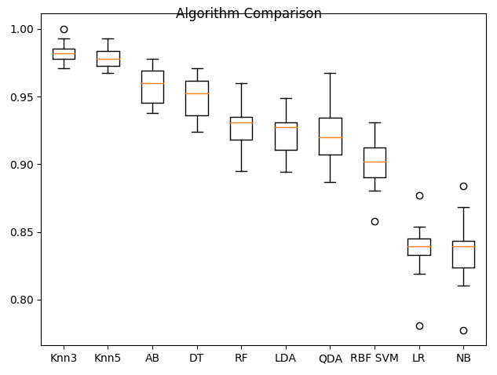
Our first aproach
Results - english tweets

Slide 35
Our first aproach
Results - english tweets, 15 splits
LogisticRegression: 0.837366 (0.019713)
LinearDiscriminantAnalysis: 0.923060 (0.014754)
KNeighborsClassifier 3: 0.982030 (0.007108)
KNeighborsClassifier 5: 0.978391 (0.007584)
Linear SVM: 0.833007 (0.020431)
RBF SVM: 0.901696 (0.018452)
DecisionTreeClassifier: 0.949755 (0.014458)
RandomForestClassifier: 0.928393 (0.017676)
MLPClassifier: 0.817467 (0.023451)
AdaBoostClassifier: 0.958020 (0.013129)
GaussianNB: 0.835416 (0.023822)
QuadraticDiscriminantAnalysis: 0.921836 (0.020412)

Slide 36
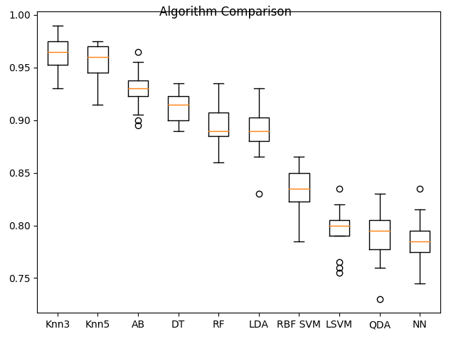
Our first aproach
Results - spanish tweets, 15 splits

Slide 37
Our first aproach
Results - spanish tweets
LogisticRegression: 0.782667 (0.022126)
LinearDiscriminantAnalysis: 0.889000 (0.022226)
KNeighborsClassifier 3: 0.963333 (0.016898)
KNeighborsClassifier 5: 0.955667 (0.016418)
Linear SVM: 0.795667 (0.021203)
RBF SVM: 0.835333 (0.020774)
DecisionTreeClassifier: 0.912333 (0.013524)
RandomForestClassifier: 0.894667 (0.019619)
MLPClassifier: 0.784000 (0.022745)
AdaBoostClassifier: 0.929667 (0.018750)
GaussianNB: 0.722667 (0.021437)
QuadraticDiscriminantAnalysis: 0.788667 (0.025197)

Slide 38
Our first aproach
Results - Voting Classifier
english, overall: 82.9%
spanish, overall: 72.8%

Slide 39
The win aproach - String Kernels
Description
The kernel function gives kernel methods the power to naturally handle input data that are not in the form of numerical vectors—for example, strings.
The kernel function captures the intuitive notion of similarity between objects in a specific domain and can be any function defined on the respective domain that is symmetric and positive definite.

Slide 40
The win aproach
Description
Perhaps one of the most natural ways to measure the similarity of two strings is to count how many substrings of length p the two strings have in common. This gives rise to the p-spectrum kernel.

Slide 41
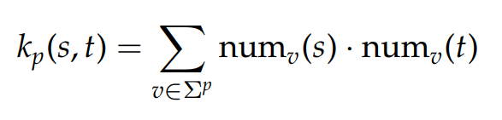
The win aproach
Description
Formally, for two strings over an alphabet Σ, s, t ∈ Σ ∗ , the p-spectrum kernel is defined as:
where numv (s) is the number of occurrences of string v as a substring in s.

Slide 42
The win aproach
Example
Given s = “pineapple” and t = “apple pie” over an alphabet Σ, and the substring length p = 2, the set of 2-grams that appear in s is denoted by S, and the set of 2-grams that appear in t is denoted by T.
The two sets S and T are given by:
S = {“pi”, “in”, “ne”, “ea”, “ap”, “pp”, “pl”, “le”}
T = {“ap”, “pp”, “pl”, “le”, “e ”, “ p”, “pi”, “ie”}

Slide 43
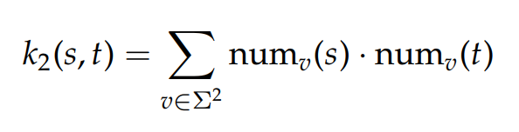

The win aproach
Example
The p-spectrum kernel between s and t can be computed as follows:
where

Slide 44
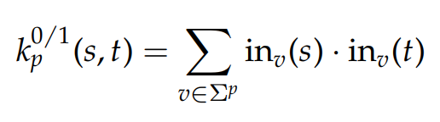
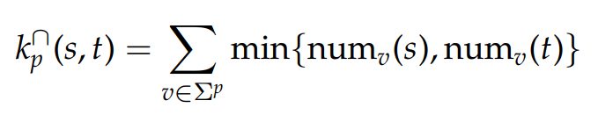
The win aproach
Others string kernels formulas
Presence bits kernel
Intersection string kernel

Slide 45
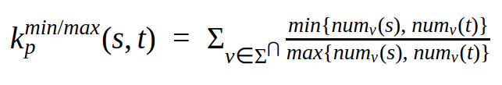

The win aproach
Our string kernel formula
where

Slide 46


The win aproach
Our string kernel formula - example
For
S = {“pi”, “in”, “ne”, “ea”, “ap”, “pp”, “pl”, “le”}
T = {“ap”, “pp”, “pl”, “le”, “e ”, “ p”, “pi”, “ie”}
we’ll have
so

Slide 47
The win aproach
Implementation tweaks
normalize the p-gram pairs counts with total counts of all p-grams for each input text.
normalize the values from kernel to be between 0 and 1.

Slide 48
The win aproach
Results with K3 - English tweets
human/bot: 93.56%
male/female: 81.82%
overall: 87.69%

Slide 49
The win aproach
Results with K3 - Spanish tweets
human/bot: 81.67%
male/female: 68.89%
overall: 75.28%

Slide 50
The win aproach
Analys results on english tweets - confusion matrix, english tweets
bot male female
bot 570 6 44
male 25 233 52
female 0 47 263

Slide 51
Our implementation
Our implementation and paper can be found at
https://github.com/adiIspas/Bots-Gender-Profiling

Slide 52
References
https://pan.webis.de/tasks.html
https://www.mitpressjournals.org/doi/pdf/10.1162/COLI_a_00256

Slide 53
Thanks!

